Slide 1

Yarmouk Private University
Faculty of Informatics
&
Communication Engineering
Department of Software Engineering
Education Assessment
System
Developed By
Seif Al-Kowatli Salim Jammoul
Supervised By
D.Engs. Talal Shehabi
D.Engs. Wassim Juneidi

Slide 2


Slide 3


Slide 4
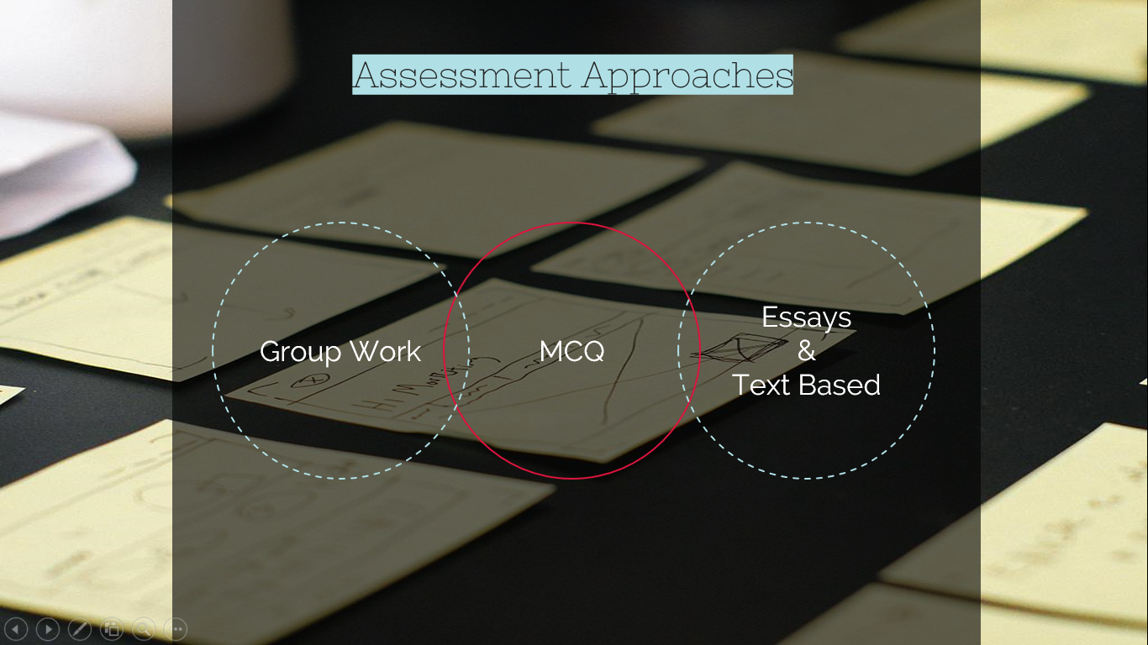

Slide 5

Placement
Summative
Formative

Slide 6

System Architecture
Examination
Endpoint
OES API
End Users
Admin
Database
Teacher
Student
EAS API
Portal
End-point

Slide 7
System Algorithms
Grandy’s Number
K-means
We used the K-Means Algorithm to perform Data-Mining on the data retrieved from the examination. The algorithm uses the data from the examination process to perform the assessment.
We used this Algorithm to generate fair and random quiz that test the students to help covering the formative assessment type of our system
CSP Algorithm
We used this algorithm to generate academic exam for the students that is fair and cover the different ILOs and topics of each course to help cover the summative and placement types of assessments.
Grandy’s
K-Means
CSP

Slide 8
Security
SSL
ASP.MVC Advantages
The usage of SSL technology ensures that all data transmitted between the web server and browser remains encrypted
Encryption
MVC secure our project against SQL Injection
And allow us to secure the project against XSS with simple and easy to use library
DoS Attacks
We Used DES Encryption Algorithm to encrypt the Question and then Encapsulate the DES Secrete Key with the RSA Encryption to Guarantee the Security of our data
To handle DoS we create HttpModule monitors all requests and block requests coming from IP addresses that make many requests in a short period of time .
Model

Slide 9

Admin
Add Course
Add Exam
Add User
Course Clustering
Exam Analysis
Semester Courses
Statistics
Student
Exam
GPA
My Marks
Teacher
Add Question
Course Analysis
Login
Codes
System Architecture
Security

Slide 10

Thank you ☺

Slide 11

Back

Slide 12
CSP Example
Thinking Skills | 10% | 40% | 10% | 20% | 20%
Difficulty | 10% | 20% | 40% | 10% | 20%
N= 20
Topics | 40% | 10% | 30% | 20%
Course
T1<Id , Parameters>
T2<Id , Parameters>
T3<Id , Parameters>
T4<Id , Parameters>
……..
……..
……..
Thinking Skills | 10% | 40% | 10% | 20% | 20%
Difficulty | 10% | 20% | 40% | 10% | 20%
Random
x N x T_{R1}
Thinking Skills | 0 | 3 | 1 | 2 | 2
Difficulty | 1 | 1 | 4 | 0 | 2
Back
Random

Slide 13
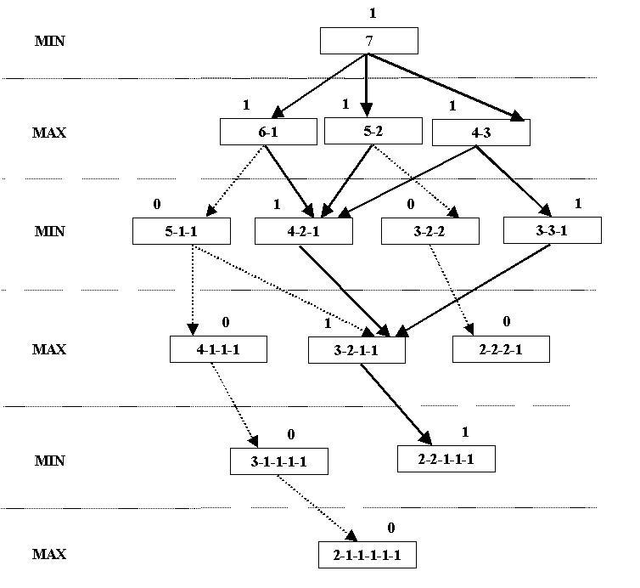
Grandy’s Number
Back

Slide 14
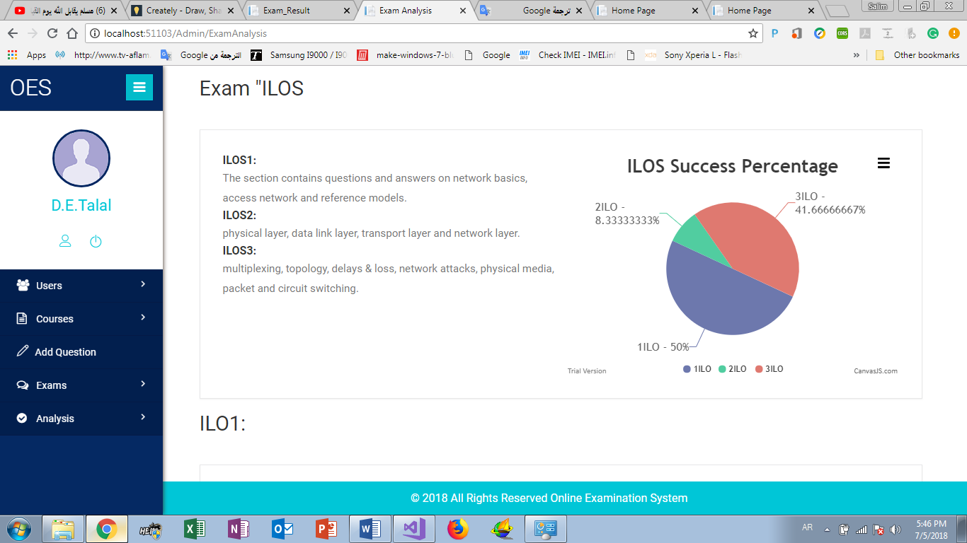
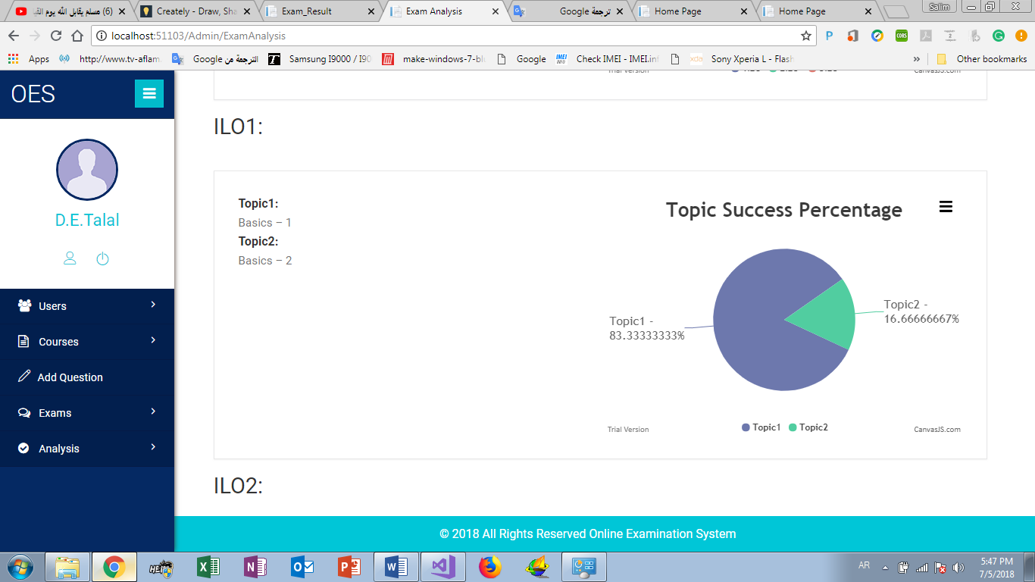
K-Means

Slide 15
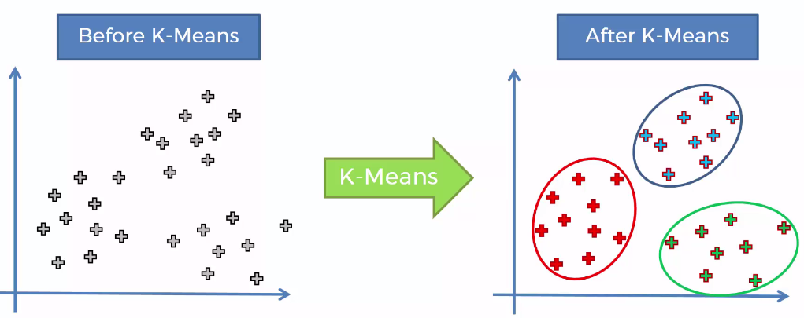

Slide 16
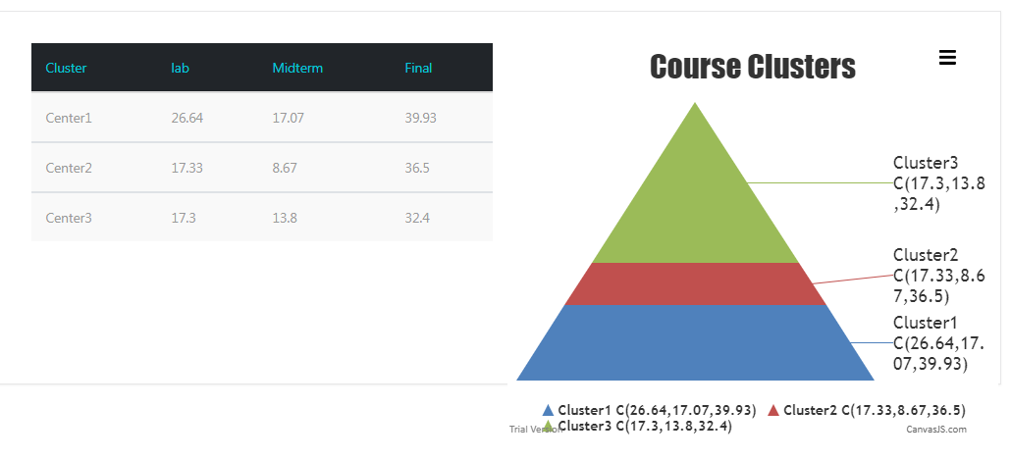
Back

